Slide 1
Search
Priliminaries
*

Slide 2
Types of Searching Algorithm
Uninformed Searching Algorithm
Informed Searching Algorithm

Slide 3
State Space Search
Basic Search Problem
  Given [S, s, O, G] where
    S is (implicitly specified) set of states.
    s is the Start State.
    O is the set of state transition operators.
    G is the set of goal states.
  Find a set of transitions leading from s to a Goal State.
*

Slide 4
Search Algorithm
Initialize: Set OPEN = {s}
Fail:
  If OPEN ={ }, Terminate with Failure
Select: Select, a state, n, form OPEN
Terminate:
  If n ∈ G, terminate with SUCCESS
Expand:
  Generate all the successors of n using O and insert them in OPEN
Loop: Goto step 2
*

Slide 5
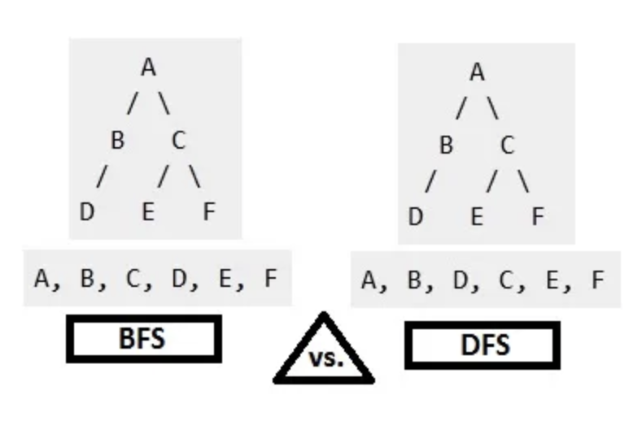
*

Slide 6
Search Algorithm
If Open {} is a stack then we implement DFS (Depth First Search)
If Open {} is a queue then we implement BFS (Breadth First Search)
Both these searches are uninformed search as they do not have any information as how to search in the graph so that it will be less time consuming or costly.
*

Slide 7
Example with DFS
1
Open [stack]
[1] Visit 1
2
3
4
6
5
7
8
*

Slide 8
Example with DFS
1
Open [stack]
[1] Visit 1
[4, 3, 2] Visit 2
2
3
4
6
5
7
8
*

Slide 9
Example with DFS
1
Open [stack]
[1] Visit 1
[4, 3] Visit 2
[4,3, 6] Visit 6
2
3
4
6
5
7
8
*

Slide 10
Example with DFS
1
Open [stack]
[1] Visit 1
[4, 3] Visit 2
[4,3, 6] Visit 6
[4, 3] Visit 3
2
3
4
6
5
7
8
*

Slide 11
Example with DFS
1
Open [stack]
[1] Visit 1
[4, 3] Visit 2
[4,3, 6] Visit 6
[4, 3] Visit 3
[4, 5] Visit 5
2
3
4
6
5
7
8
*

Slide 12
Example with DFS
1
Open [stack]
[1] Visit 1
[4, 3] Visit 2
[4,3, 6] Visit 6
[4, 3] Visit 3
[4, 5] Visit 5
[4, 7] Visit 7
Goal Found
2
3
4
6
5
7
8
*

Slide 13
Example with BFS
1
Open [queue]
[1] Visit 1
2
3
4
6
5
7
8
*

Slide 14
Example with BFS
1
Open [queue]
[1] Visit 1
[2, 3, 4] Visit 2
2
3
4
6
5
7
8
*

Slide 15
Example with BFS
1
Open [queue]
[1] Visit 1
[2, 3, 4] Visit 2
[3, 4, 6] Visit 3
2
3
4
6
5
7
8
*

Slide 16
Example with BFS
1
Open [queue]
[1] Visit 1
[2, 3, 4] Visit 2
[3, 4, 6] Visit 3
[4, 6, 5] Visit 4
2
3
4
6
5
7
8
*

Slide 17
Example with BFS
1
Open [queue]
[1] Visit 1
[2, 3, 4] Visit 2
[3, 4, 6] Visit 3
[4, 6, 5] Visit 4
[6, 5, 7] Visit 6
2
3
4
6
5
7
8
*

Slide 18
Example with BFS
1
Open [queue]
[1] Visit 1
[2, 3, 4] Visit 2
[3, 4, 6] Visit 3
[4, 6, 5] Visit 4
[6, 5, 7] Visit 6
[5, 7] Visit 5
2
3
4
6
5
7
8
*

Slide 19
Example with BFS
1
Open [queue]
[1] Visit 1
[2, 3, 4] Visit 2
[3, 4, 6] Visit 3
[4, 6, 5] Visit 4
[6, 5, 7] Visit 6
[5, 7] Visit 5
[7] Visit 7
Goal Found
2
3
4
6
5
7
8
*

Slide 20
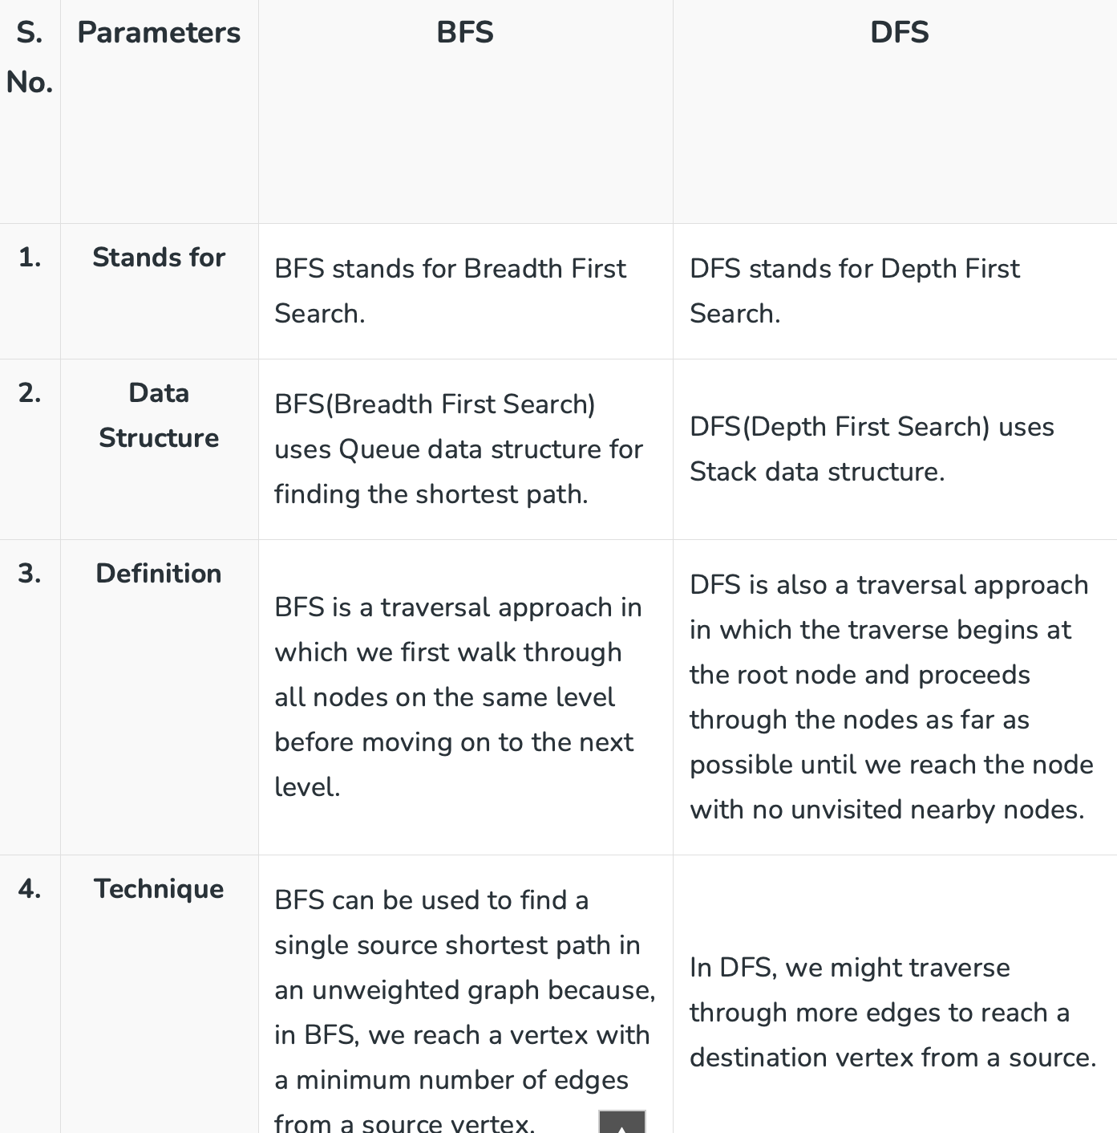

Slide 21
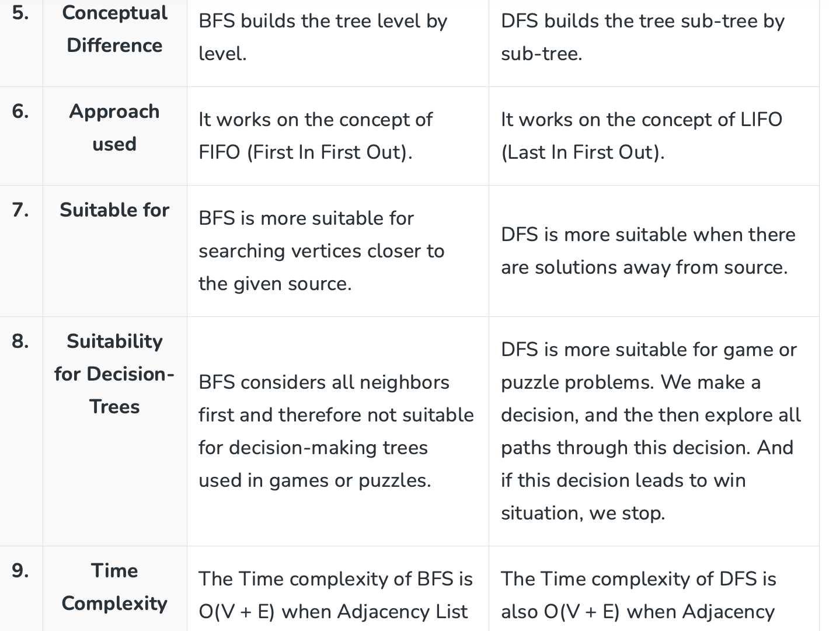

Slide 22
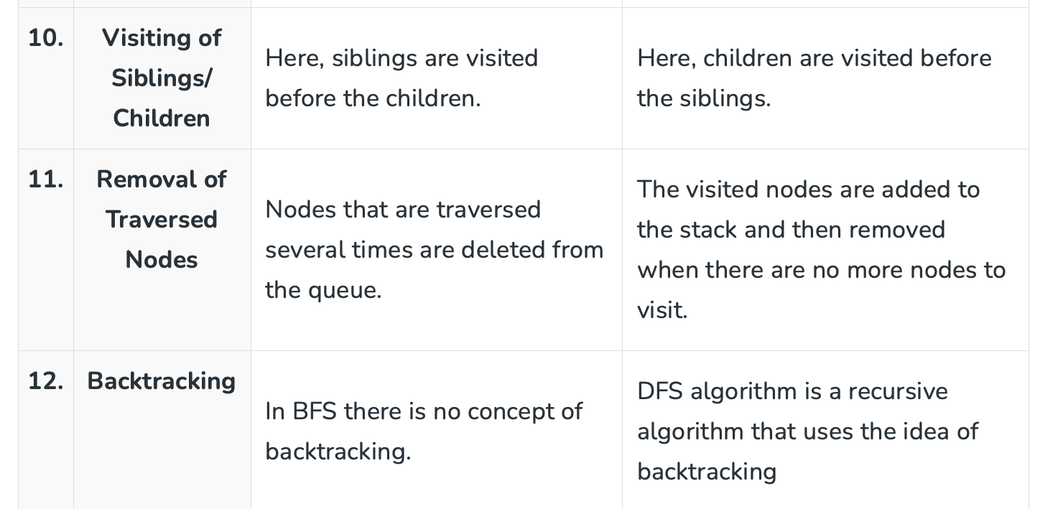

Slide 23
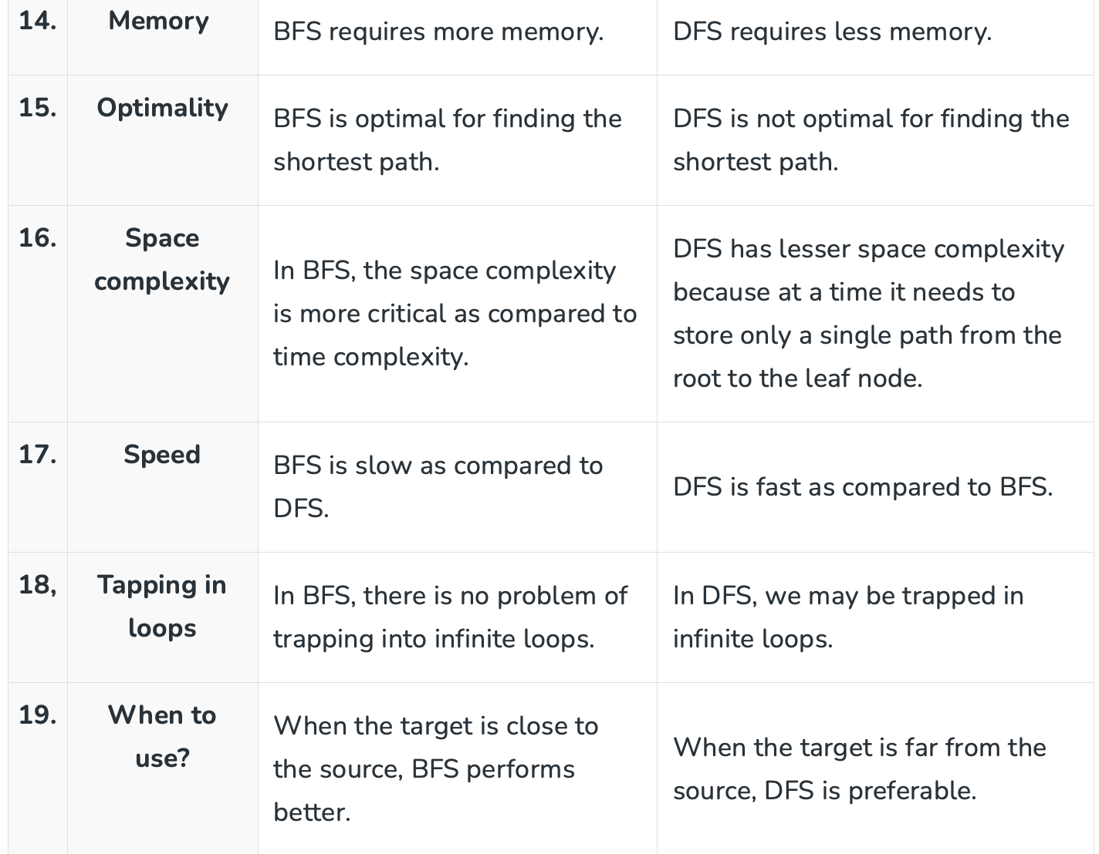

Slide 24
Iterative Deepening Search
Mix of Both DFS and BFS
Here, at a given depth all the nodes are traversed and kept in open which is a stack.
One by one each is searched for goal node
If found then the search is successful
Else we move to next depth/level and continue the process
*

Slide 25
Iterative Deepening
Initialize: Set OPEN = {s}; depth=1
Fail:
  If OPEN ={ }, Terminate with Failure
Select: Select, a state, n, form OPEN
Terminate:
  If n ∈ G, terminate with SUCCESS
Expand:
  Generate the successors of all the states at depth using O and insert them in OPEN;
  depth = depth + 1
Loop: Goto step 2
*

